Slide 1
HW4 Solutions
Dr. Shengquan Wang

Slide 2
Q1
P(a|a) = (1+2)/(8+2*3) = 3/14
P(b|a) = (6+2)/(8+2*3) = 8/14
P(c|a) = (1+2)/(8+2*3) = 3/14
P(a|b) = (3+2)/(12+2*3) = 5/18
P(b|b) = (2+2)/(12+2*3) = 4/18
P(c|b) = (7+2)/(12+2*3) = 9/18
P(a|c) = (4+2)/(11+2*3) = 6/17
P(b|c) = (3+2)/(11+2*3) = 5/17
P(c|c) = (4+2)/(11+2*3) = 6/17

Slide 3
Q2
P(yes) = (9+2)/(14+2*2) = 11/18
P(no) = (5+2)/(14+2*2) = 7/18
P(sunny|yes) = (2+2)/(9+2*3) = 4/15
P(sunny|no) = (3+2)/(5+2*3) = 5/11
P(cool|yes) = (3+2)/(9+2*3) = 5/15
P(cool|no) = (1+2)/(5+2*3) = 3/11
P(high|yes) = (3+2)/(9+2*2) = 5/13
P(high|no) = (4+2)/(5+2*2) = 6/9
P(false|yes) = (6+2)/(9+2*2) = 8/13
P(false|no) = (2+2)/(5+2*2) = 4/9
P(no|sunny,cool,high,false) ∝ P(sunny|no) * P(cool|no) * P(high|no) * P(false|no) * P(no) = 5/11 * 3/11 * 6/9 * 4/9 * 7/18 = 0.01428
P(yes|sunny,cool,high,false) ∝ P(sunny|yes) * P(cool|yes) * P(high|yes) * P(false|yes) * P(yes) = 4/15 * 5/15 * 5/13 * 8/13 * 11/18 = 0.01286
P(no|sunny,cool,high,false) = 0.01428 /(0.01428 + 0.01286) = 0.52616 > 0.5
So No with higher probability.

Slide 4
Q3
Root:
Gain(outlook) = 0.9403 – 0.6935 = 0.2468
Gain(temperature) = 0.9403 – 0.9111 = 0.0292
Gain(humility) = 0.9403 – 0.7885 = 0.1518
Gain(windy) = 0.9403 – 0.8921 = 0.0482
outlook

Slide 5
Q3
rainy:
Gain(windy) = 0.9710
Gain(temperature) = 0.02
Gain(humidity) = 0.02
sunny:
Gain(humidity) = 0.9710
Gain(temperature) = 0.571
Gain(windy) = 0.02
outlook
rainy
sunny
overcast
windy
yes
humidity
false
true
normal
high
yes
no
yes
no
For the test data, the result is no

Slide 6
Q4
If x=price and y=size
w₁ = (6*791.75 – 620 * 7.05) / (6*73800-620²) = 0.00649828767
w₀ = (7.05 - 0.00649828767 * 620) / 6 = 0.50351027397
size = 0.00649828767 * price + 0.50351027397

Slide 7
Q5
Height | Weight | Size | M-Distance
158 | 58 | M | 6
158 | 59 | M | 5
158 | 63 | M | 5
160 | 59 | M | 3
160 | 60 | M | 2
163 | 60 | M | 3
163 | 61 | M | 2
160 | 64 | L | 4
163 | 64 | L | 5
165 | 61 | L | 4
165 | 62 | L | 5
165 | 65 | L | 8
168 | 62 | L | 8
168 | 63 | L | 9
168 | 66 | L | 12
170 | 63 | L | 11
170 | 64 | L | 12
170 | 68 | L | 16
Height | Weight | Size | M-Distance
158 | 58 | M | 7
158 | 59 | M | 6
158 | 63 | M | 10
160 | 59 | M | 4
160 | 60 | M | 5
163 | 60 | M | 2
163 | 61 | M | 3
160 | 64 | L | 9
163 | 64 | L | 6
165 | 61 | L | 3
165 | 62 | L | 4
165 | 65 | L | 7
168 | 62 | L | 7
168 | 63 | L | 8
168 | 66 | L | 11
170 | 63 | L | 10
170 | 64 | L | 11
170 | 68 | L | 15
M for (Height=161, Weight=61)
M for (Height=164, Weight=59)

Slide 8
Q6
x | y | Centroid 1 |  | E-Distance | Centroid 2 |  | E-Distance
24.5 | 3.5 | 12 | 12.5 | 15.40 | 15 | 15.5 | 15.31
26.5 | 7 | 12 | 12.5 | 15.51 | 15 | 15.5 | 14.30
21.5 | 7.5 | 12 | 12.5 | 10.74 | 15 | 15.5 | 10.31
25 | 15.5 | 12 | 12.5 | 13.34 | 15 | 15.5 | 10.00
2.5 | 20.5 | 12 | 12.5 | 12.42 | 15 | 15.5 | 13.46
9.5 | 23 | 12 | 12.5 | 10.79 | 15 | 15.5 | 9.30
11 | 20 | 12 | 12.5 | 7.57 | 15 | 15.5 | 6.02
21.5 | 4 | 12 | 12.5 | 12.75 | 15 | 15.5 | 13.21
 |  | New Centroid 1 |  |  | New Centroid 2
 |  | 12 | 12.25 |  | 19.67 | 12.75

Slide 9
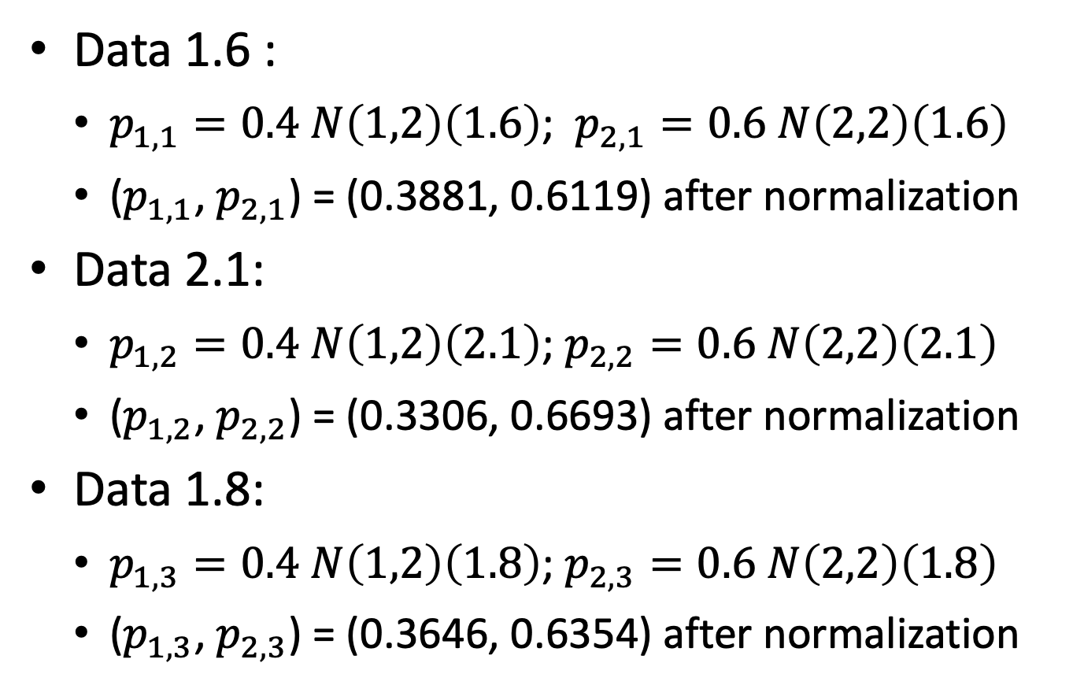
Q7 (E-Step)
Data 1.6 :
$p_{1,1}=0.4 N\left(1,2\right)\left(1.6\right)$; $p_{2,1}=0.6 N\left(2,2\right)\left(1.6\right)$
($p_{1,1}$, $p_{2,1}$) = (0.3881, 0.6119) after normalization
Data 2.1:
$p_{1,2}=0.4 N\left(1,2\right)\left(2.1\right)$; $p_{2,2}=0.6 N\left(2,2\right)\left(2.1\right)$
($p_{1,2}$, $p_{2,2}$) = (0.3306, 0.6693) after normalization
Data 1.8:
$p_{1,3}=0.4 N\left(1,2\right)\left(1.8\right)$; $p_{2,3}=0.6 N\left(2,2\right)\left(1.8\right)$
($p_{1,3}$, $p_{2,3}$) = (0.3646, 0.6354) after normalization

Slide 10
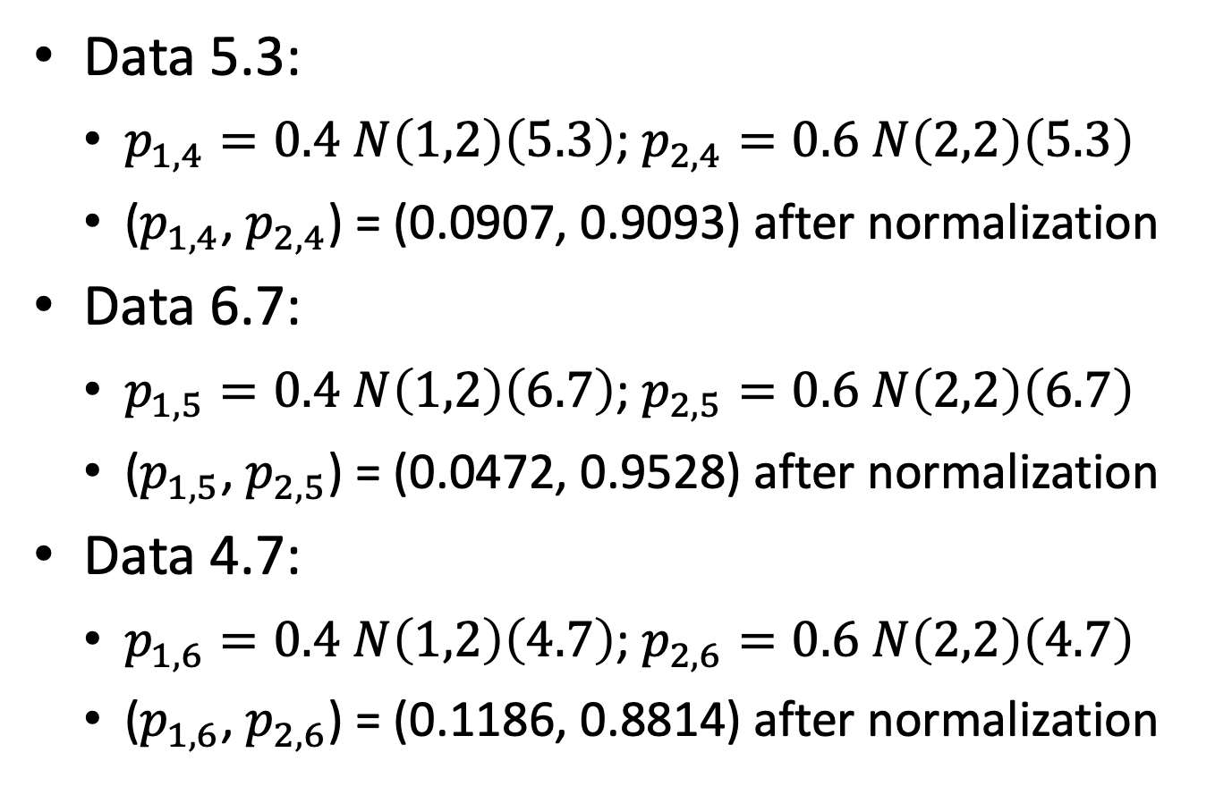
Q7 (E-Step)
Data 5.3:
$p_{1,4}=0.4 N\left(1,2\right)\left(5.3\right)$; $p_{2,4}=0.6 N\left(2,2\right)\left(5.3\right)$
($p_{1,4}$, $p_{2,4}$) = (0.0907, 0.9093) after normalization
Data 6.7:
$p_{1,5}=0.4 N\left(1,2\right)\left(6.7\right)$; $p_{2,5}=0.6 N\left(2,2\right)\left(6.7\right)$
($p_{1,5}$, $p_{2,5}$) = (0.0472, 0.9528) after normalization
Data 4.7:
$p_{1,6}=0.4 N\left(1,2\right)\left(4.7\right)$; $p_{2,6}=0.6 N\left(2,2\right)\left(4.7\right)$
($p_{1,6}$, $p_{2,6}$) = (0.1186, 0.8814) after normalization

Slide 11

Q7 (M-Step)
$π=$ (0.2233, 0.7767)
$μ=\text{(}\text{2.4823,} \text{4.0501}\text{)}$
$σ^{2}=(\text{1.9875}\text{,} \text{3.8452})$

Slide 12
Q8
w₀: 1
-0.525
*
-5
x₀: -5
0.105
+
1
w₁: -2
0.105
-0.315
*
6
-2
0.1192
+
σ
0.105
0.105
1
x₁: -3
b: -3
0.105

